Slide 1


Mario Gomez-Rey
11/12/2024

Slide 2

Outline
Executive Summary
Introduction
Methodology
Results
Conclusion
Appendix

Slide 3
Executive Summary
Summary of methodologies
Summary of all results

Slide 4
Introduction
Project background and context
Problems you want to find answers

Slide 5

Section 1

Slide 6
Methodology
Executive Summary
Data collection methodology:
For this data science project, we employed a methodology combining web scraping and API integration to gather and analyze data from diverse online sources, ensuring comprehensive and up-to-date insights.
Perform data wrangling
The data wrangling process involved cleaning, transforming, and organizing raw data into a structured format suitable for analysis. This included handling missing values, removing duplicates, standardizing formats, and converting data types.
Perform exploratory data analysis (EDA) using visualization and SQL
Perform interactive visual analytics using Folium and Plotly Dash
Perform predictive analysis using classification models
To build a classification model, we first select an appropriate algorithm (e.g., logistic regression, decision trees, or random forests) and train it using labeled data. Model performance is then tuned by adjusting hyperparameters, such as learning rate or tree depth, and evaluated using metrics like accuracy, precision, recall, and F1-score to ensure optimal predictive performance on unseen data.

Slide 7
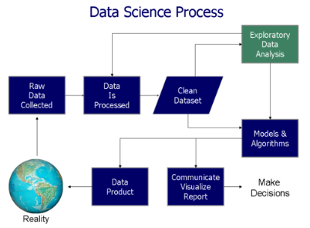
Data Collection
The data collection process begins by defining the data requirements to identify the types of data needed for the project. Once the data needs are clear, two methods are used: web scraping and APIs.
For web scraping, we select target websites, extract HTML content, parse it, clean the data, and store it for further use. Similarly, for APIs, we identify suitable APIs, authenticate access, fetch data, clean and parse it, then store it.
Finally, all collected data is stored in a structured format, followed by preprocessing to clean and organize it, preparing it for analysis.

Slide 8
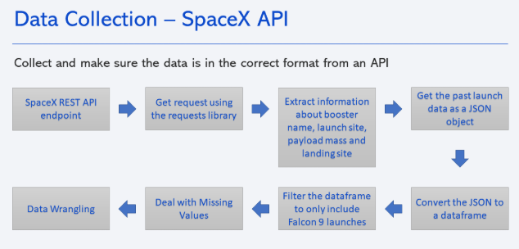
Data Collection – SpaceX API
Accessing the SpaceX API
Connecting and Authenticating with the API
Retrieving Data through API Calls
Parsing and Processing JSON Data
Cleaning, Structuring, and Storing Data for Analysis
Github Link - SpaceX API

Slide 9
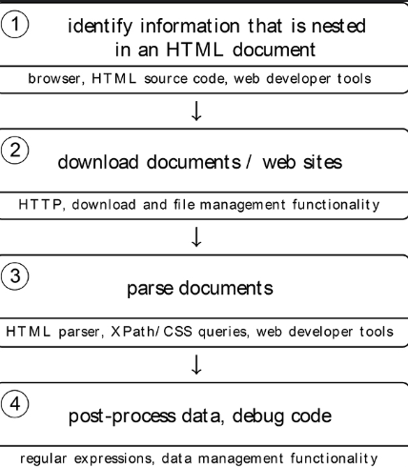
Data Collection - Scraping
Identifying Target Wikipedia Page and Table
Extracting HTML Table Data Using Web Scraping Libraries
Parsing Table Content into Structured Format
Cleaning Unnecessary Data and Formatting
Storing Cleaned Data for Further Analysis
Github Link Webscrapping

Slide 10
Data Wrangling
Identifying and Handling
Missing DataRemoving
Duplicates and Inconsistent Entries
Standardizing Data Formats and Types
Handling Outliers and Data Corrections
Merging and Integrating Datasets for Analysis
Github Link Wrangling

Slide 11
EDA with Data Visualization
Choosing the Right Visualization Tools and Libraries
Creating Clear and Informative Charts
Visualizing Trends and Patterns in Data
Customizing Visuals for Better Clarity and Impact
Interpreting and Communicating Insights from Visuals
Github Link Data Visualization

Slide 12
EDA with SQL
Querying Data with SELECT Statements
Filtering and Sorting Data Using WHERE and ORDER BY
Aggregating Data with GROUP BY and Aggregation Functions
Joining Multiple Tables for Comprehensive Analysis
Optimizing Queries for Efficiency and Performance
Github Link SQL

Slide 13
Build an Interactive Map with Folium
Introduction to Folium for Interactive Maps
Creating Basic Maps with Markers and Layers
Customizing Map Styles and Appearance
Adding Interactive Features like Popups and Tooltips
Integrating External Data for Dynamic Visualization
Github Link Map Folium

Slide 14
Build a Dashboard with Plotly Dash
Summarize what plots/graphs and interactions you have added to a dashboard
Explain why you added those plots and interactions
Add the GitHub URL of your completed Plotly Dash lab, as an external reference and peer-review purpose

Slide 15
Predictive Analysis (Classification)
Exploring Classification Algorithms: Logistic Regression, SVM, and Decision Trees
Preparing Data for Classification: Feature Engineering and Preprocessing
Training and Tuning Models: Random Forests and K-Nearest Neighbors
Evaluating Model Performance: Accuracy, Precision, Recall, and F1-Score
Interpreting Results: Insights from Naive Bayes and Neural Networks
Summarize how you built, evaluated, improved, and found the best performing classification model
Github Link Analysis

Slide 16
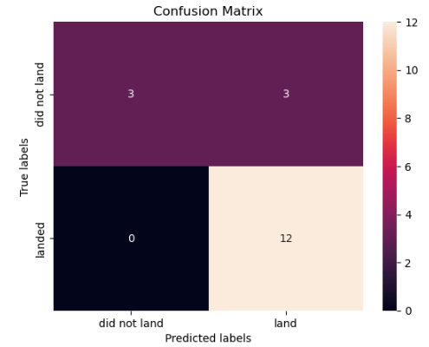
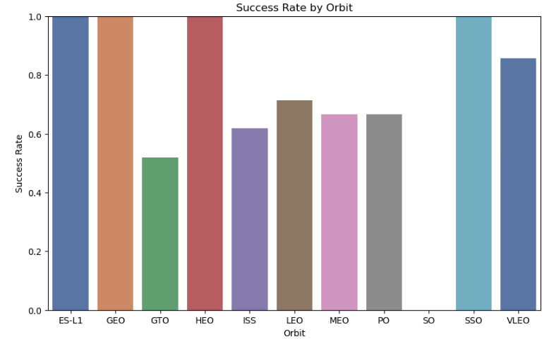
Results

Slide 17

Section 2

Slide 18
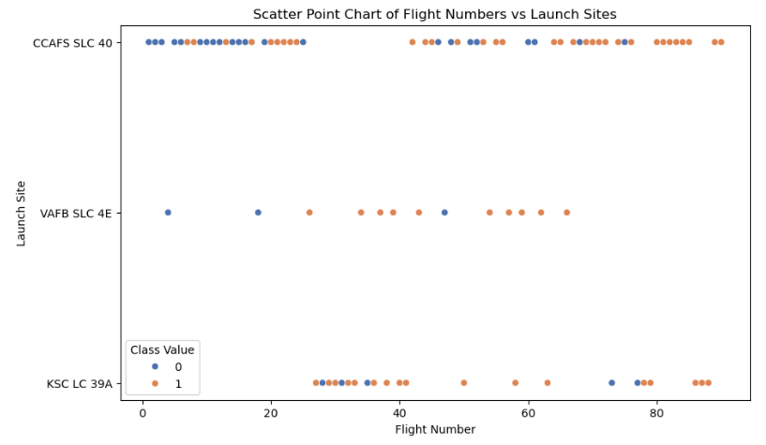
Flight Number vs. Launch Site

Slide 19
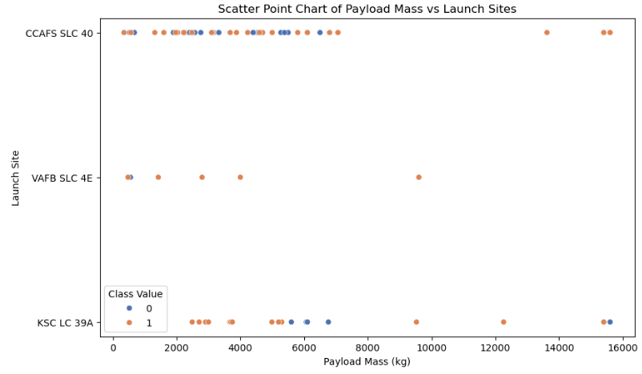
Payload vs. Launch Site

Slide 20
Success Rate vs. Orbit Type

Slide 21
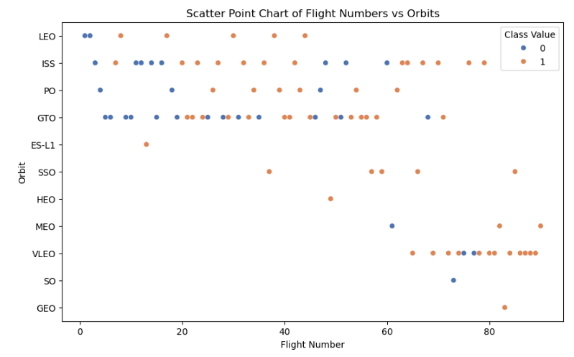
Flight Number vs. Orbit Type

Slide 22
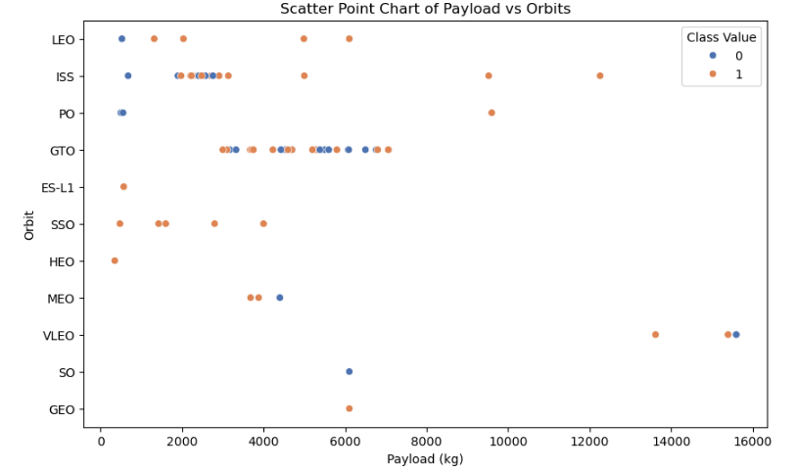
Payload vs. Orbit Type

Slide 23
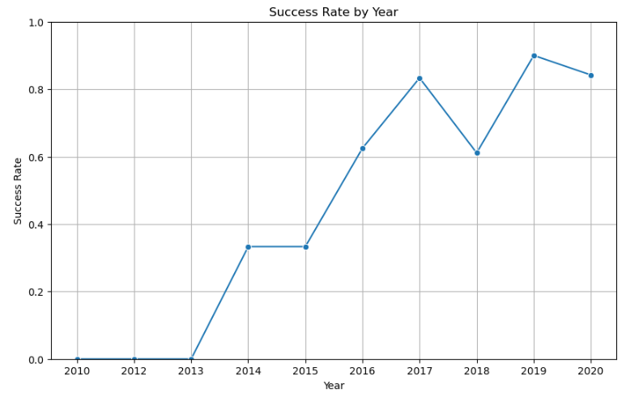
Launch Success Yearly Trend

Slide 24
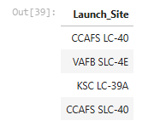
All Launch Site Names

Slide 25
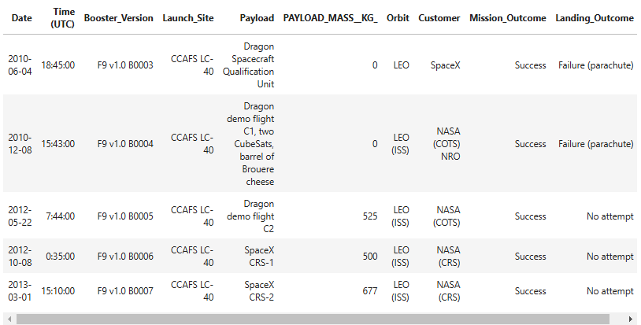
Launch Site Names Begin with 'CCA'

Slide 26
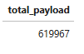
Total Payload Mass

Slide 27
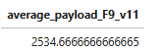
Average Payload Mass by F9 v1.1

Slide 28
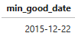
First Successful Ground Landing Date

Slide 29
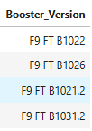
Successful Drone Ship Landing with Payload between 4000 and 6000

Slide 30
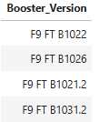
Total Number of Successful and Failure Mission Outcomes

Slide 31
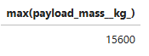
Boosters Carried Maximum Payload

Slide 32
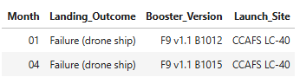
2015 Launch Records

Slide 33
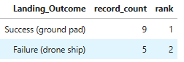
Rank Landing Outcomes Between 2010-06-04 and 2017-03-20

Slide 34

Section 3

Slide 35
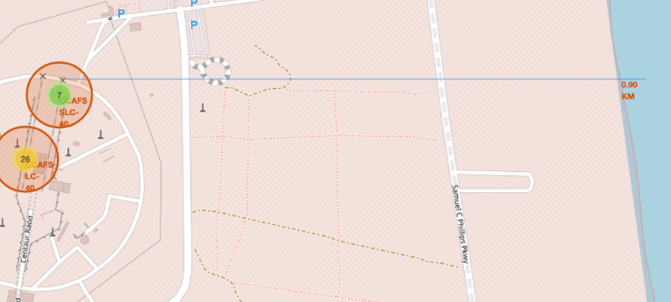
Distance to Sea

Slide 36
<Folium Map Screenshot 2>
Replace <Folium map screenshot 2> title with an appropriate title
Explore the folium map and make a proper screenshot to show the color-labeled launch outcomes on the map
Explain the important elements and findings on the screenshot

Slide 37
<Folium Map Screenshot 3>
Replace <Folium map screenshot 3> title with an appropriate title
Explore the generated folium map and show the screenshot of a selected launch site to its proximities such as railway, highway, coastline, with distance calculated and displayed
Explain the important elements and findings on the screenshot

Slide 38

Section 4

Slide 39
<Dashboard Screenshot 1>
Replace <Dashboard screenshot 1> title with an appropriate title
Show the screenshot of launch success count for all sites, in a piechart
Explain the important elements and findings on the screenshot

Slide 40
<Dashboard Screenshot 2>
Replace <Dashboard screenshot 2> title with an appropriate title
Show the screenshot of the piechart for the launch site with highest launch success ratio
Explain the important elements and findings on the screenshot

Slide 41
<Dashboard Screenshot 3>
Replace <Dashboard screenshot 3> title with an appropriate title
Show screenshots of Payload vs. Launch Outcome scatter plot for all sites, with different payload selected in the range slider
Explain the important elements and findings on the screenshot, such as which payload range or booster version have the largest success rate, etc.

Slide 42

Section 4

Slide 43
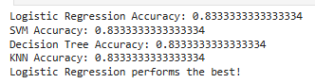
Classification Accuracy

Slide 44
Confusion Matrix

Slide 45
Conclusions
Over 90% success rate for Falcon 9 launches, with cost reductions due to reusability.
Falcon 9 Block 5 shows higher success rates; Cape Canaveral launches are more reliable.
Rocket type, and payload weight significantly affect launch success.
Focus on optimizing reusability, pre-launch testing, and real-time data monitoring

Slide 46
Appendix
Include any relevant assets like Python code snippets, SQL queries, charts, Notebook outputs, or data sets that you may have created during this project

Slide 47


